Slide 1



Predicting satellite-to-ground propagation effects induced by the Ionosphere
Joshua Smith
Mentor : Dr. Mike Parker
Rincon Research Corporation
April 18, 2020
Virtual symposium

Slide 2
CatSat
The University of Arizona is launching a 6U CubeSat called CatSat in the Spring of 2021
One hurdle Cat-Sat will face is dealing with Ionospheric propagation effects
Source: https://uanews.arizona.edu/story/ua-studentled-catsat-mission-selected-nasa
Statement of the problem;
CatSat’s orbit is projected to near 550 km
Notes:
Statement of the problem;
CatSat’s orbit is projected to near 550 km

Slide 3
The Problem with The Ionosphere
Statement of the problem;
The Ionosphere contains high concentration of electrons that can effect signals passing through it.
Source: https://spotlight.unavco.org/how-gps-works/gps-basics/gps-and-geosciences.html

Slide 4
Objectives: Predicting Propagation Effects
For CatSat’s mission, it would be very helpful to predict these effects induced by the Ionosphere
Number of Faraday Rotations
Time Delay/ Total Slant Electron Content
Changes in Frequency

Slide 5
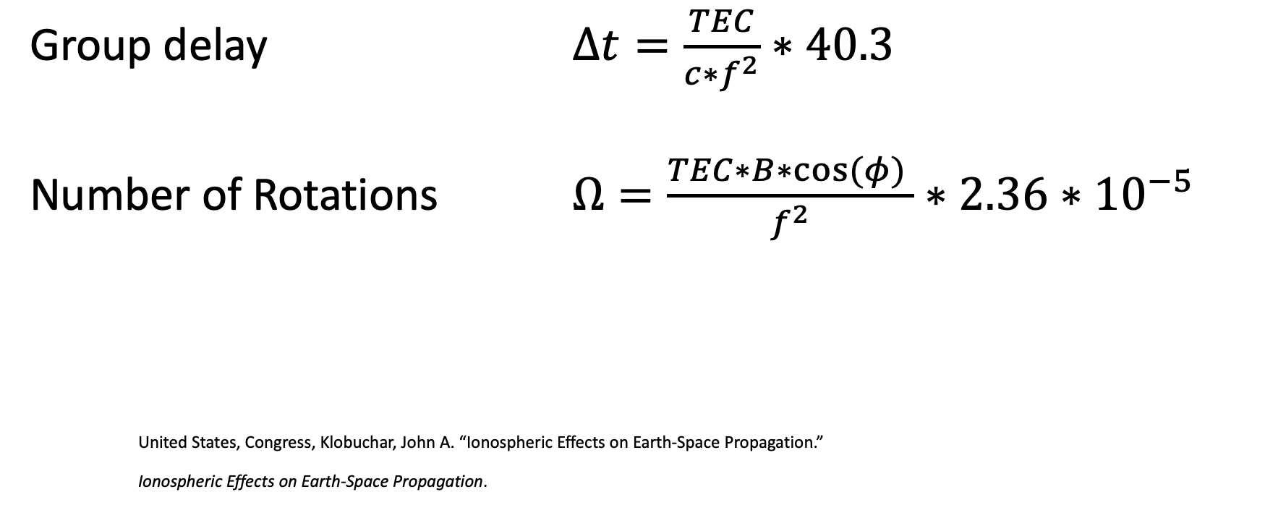
Input: Satellites Orbit path, frequency, Vertical TEC, Ground Station coordinates,
Group delay $∆t=\frac{TEC}{c∗f^{2}}∗40.3$
Number of Rotations $Ω=\frac{TEC∗B∗cos⁡(φ) }{f^{2}}∗2.36∗{10}^{−5}$
United States, Congress, Klobuchar, John A. “Ionospheric Effects on Earth-Space Propagation.”
Ionospheric Effects on Earth-Space Propagation.
Notes:
Using equations obtained from John A Kolobuchar paper Total elctron Content studies,
I wrote C code that allows you to input given coordinates for a ground station, Vertical Total Electron content, a salatites postion Data optained form a SPG module
To produce Group delay/Slant Total electron and number of faraday rotations for passes over that ground station, given the satalites transmitting at 100 MegaHertz

Slide 6
Main Assumptions
Nonvarying Vertical Total Electron Content
Thin shell for the Ionosphere at an Altitude of 400 Km
Spherical Model of the Earth
Dipole Model of the Earths Magnetic
Ray Paths are not being Bent or refracted by the Ionosphere
Notes:
Using equations obtained from John A Kolobuchar paper Total elctron Content studies,
I wrote C code that allows you to input given coordinates for a ground station, Vertical Total Electron content, a salatites postion Data optained form a SPG module
To produce Group delay/Slant Total electron and number of faraday rotations for passes over that ground station, given the satalites transmitting at 100 MegaHertz

Slide 7
Test Case Input
Let’s Say CatSat has an Orbit altitude near 550 km
Has an orbit path similar to Landsat-7
The Vertical TEC = 10^18 electrons/m^2
Transmitting at f = 100 MHZ
Ground station is at Lat: 32 Long: -111 (Tucson)

Slide 8
Test Case Expectations (Not To Scale)
CatSat
CatSat
Line of Sight
VTEC = 10E18 el/m^2
STEC>VTEC
GD
Ionosphere

Slide 9
Test Case Expectations (Not To Scale)
CatSat
Magnetic Field Vectors
CatSat
CatSat
GD
Magnetic North
Pole

Slide 10
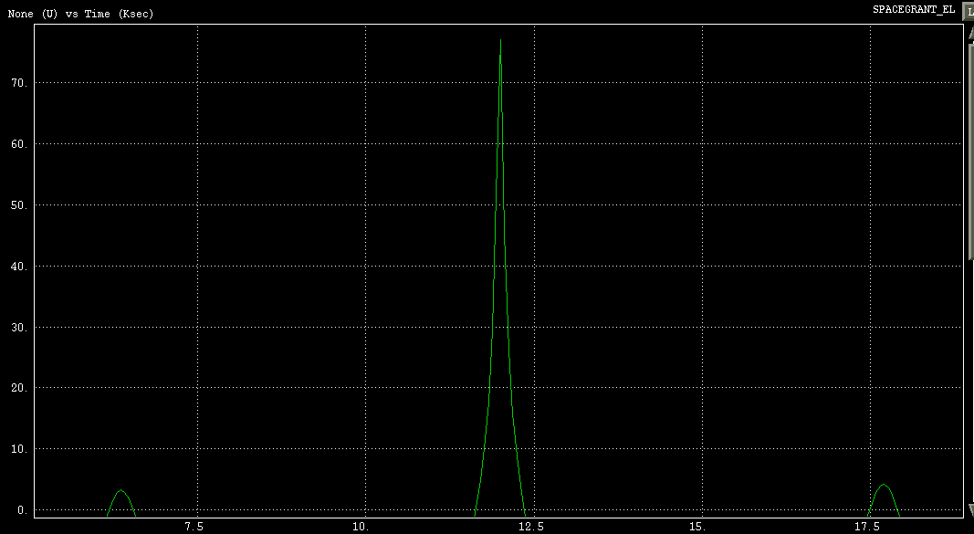
Elevation angle (degrees) Vs Time (Ksec)

Slide 11
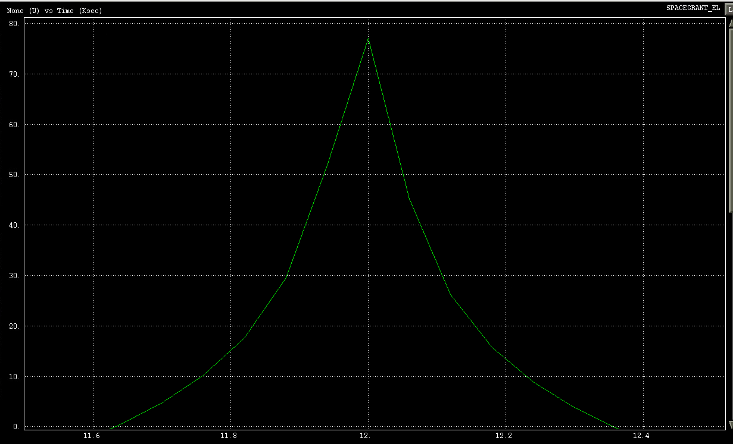
Elevation angle (degrees) Vs Time (Ksec)

Slide 12
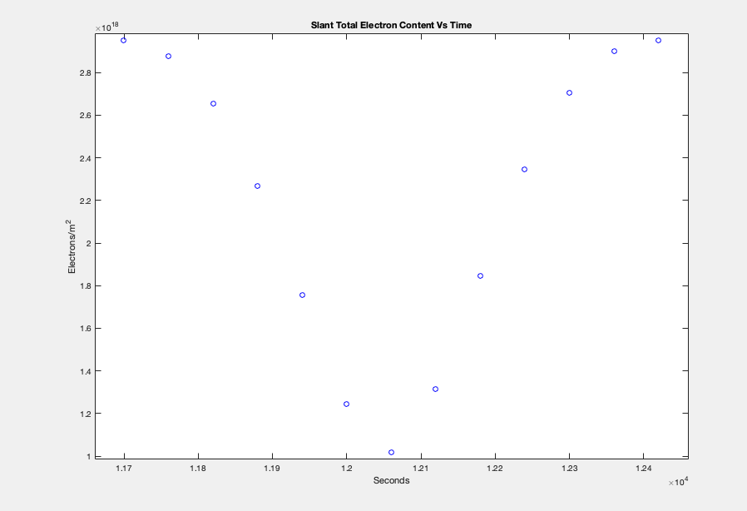
Results

Slide 13
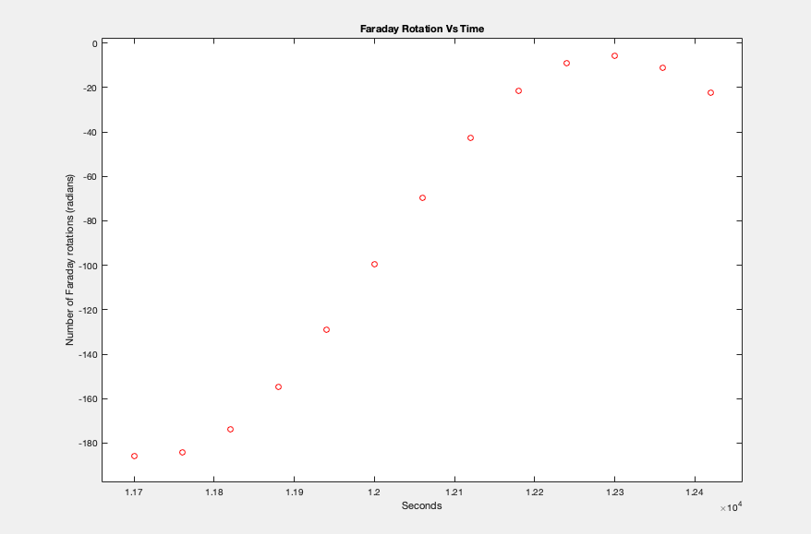

Slide 14
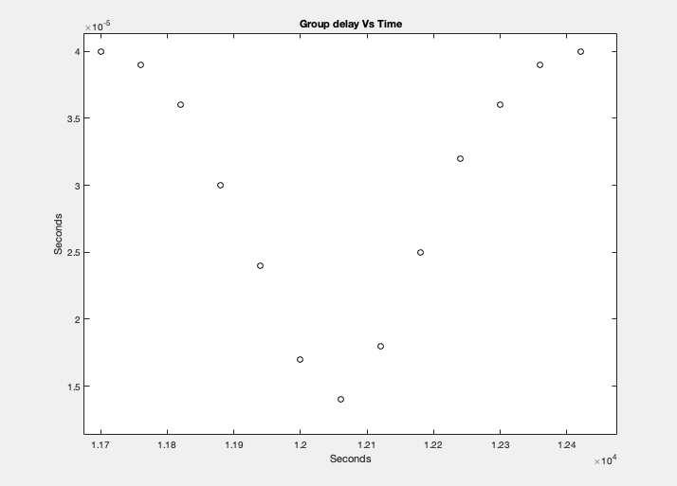
Results

Slide 15
Why These Predictions are Important
Number of Faraday Rotations
If we measure fading amplitude, when our model suggests it should be higher, could suggest something has happened (i.e. Spinning)
Time Delay
Can Give us a better understanding of how the Ionosphere behaves
Changes in Frequency
Transmitter needs to tuned to the same frequency being received
Notes:
Interpretations of these predictions
Match how STEC should increase at the horizons and reach a minuim when directly above the GD
Matches the behavior of how Faraday rotation should reverse in direction for this high pass
Skeptical about magnitude of FR
Don’t know actual TEC, it can vary greatly but we can measure the # of faraday Rotations
Worst case scenario
Model can tell us if something is wrong

Slide 16
Conclusion/Future work
Predictions seem to match behavior of our expectations
Possible Problems with magnitude for FR
Future work
Integrate code into Rincon Research’s X-midas server
Finish coding for the induced change in Frequency
Enhance Code so that it reflects more realistic situations (i.e. Magnetic field)

Slide 17
Acknowledgements
Thank you so much to….
Dr. Mike Parker
Rincon Research
David Chan
Michelle Coe
Arizona Space Grant Consortium

Slide 18
Thank You!!

Slide 19
